Slide 2

Workshop 6. More LLM & Database Integration
Extract Inquiry Questions
Database Integration
Assignment 3

Slide 3

Integrate LLM service using Python
LLM API – Prompt Engineering
Techniques – Recap
Use Clear and Specific Instructions
Use Chain of Thought (CoT) Reasoning
Few-Shot Prompting - Giving Examples
Roles Specification for Contextual Accuracy
Formatting Output for Clarity
Prompt Chaining (Multi-Step Prompts)
Set Constraints on the Response

Slide 4
Integrate LLM service using Python
LLM API – Prompt Engineering
Make it more useful
Extract the sender and receiver names
Extract all the inquiry questions from this email

Slide 5
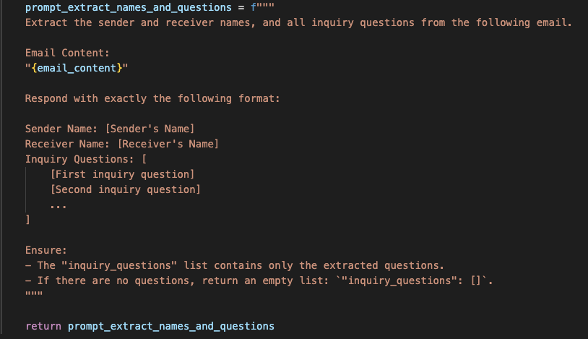
Integrate LLM service using Python
LLM API – Extract inquiry questions
1. Update the prompt

Slide 6
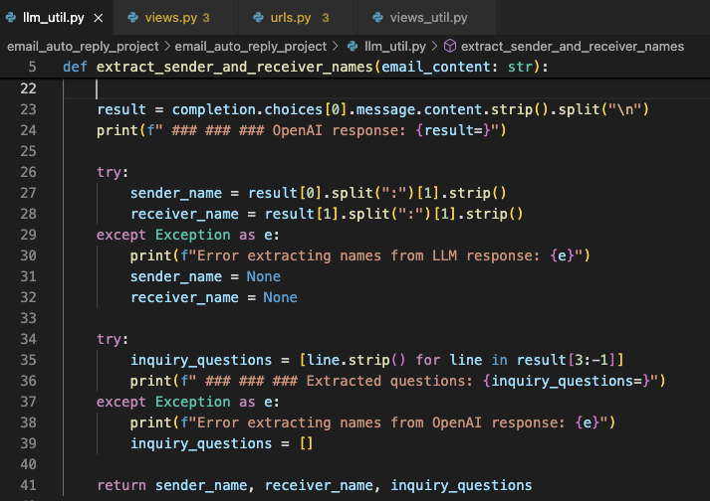
Integrate LLM service using Python
LLM API – Extract inquiry questions
2. Parse LLM response

Slide 7
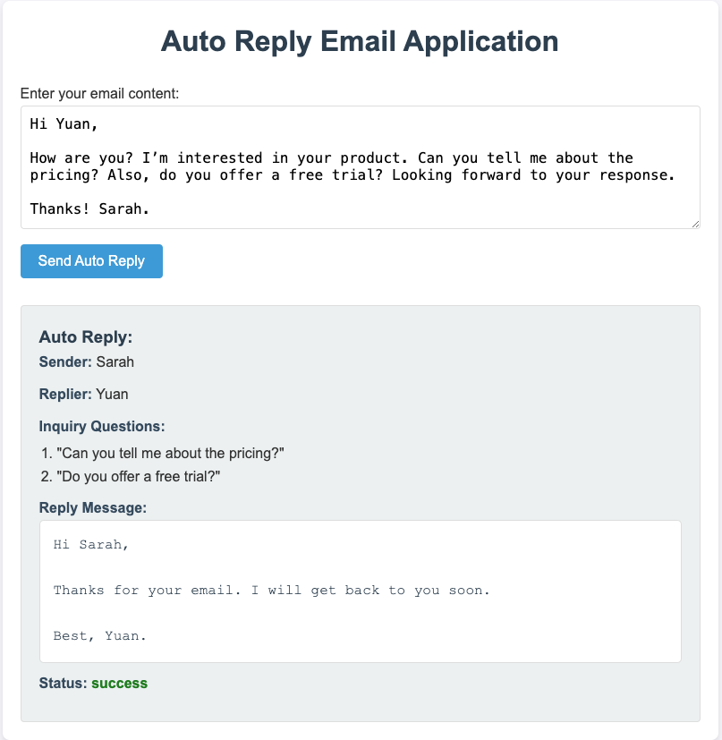
Integrate LLM service using Python
LLM API – Extract inquiry questions
3. Test and troubleshooting

Slide 8
Integrate LLM service using Python
LLM API – Extract inquiry questions
4. More testing
Extracting questions from text is more complex than extracting names.
There are challenges in both the LLM side and the parsing logic,
LLM hallucination
Unpredictable LLM API response data structure
How to make it more robust?

Slide 9

Any questions?

Slide 10
Integrate LLM service using Python
LLM API – Extract inquiry questions
What's more?
Extract action items
Summarize long content
Categorize email based on content
etc.
Your turn – modify the prompt and try to solve different types of tasks listed above, and evaluate LLM's performance on each type of task.

Slide 11
Workshop 6. More LLM & Database Integration
Extract Inquiry Questions
Database Integration
Assignment 3

Slide 12
Integrate LLM service using Python
Database Integration – Use Case
Motivation, aka. User Story
As a user,
I would like the application to extract all the inquiry questions from my emails
I can review all inquiry questions history
I can answer the listed questions by typing in the input box
It would be great if the application can aggregate identical questions and apply the existing answer to it so that I don't have to repeat answering the same questions

Slide 13
Integrate LLM service using Python
Database Integration – Use Case
Solution
I would like the application to extract all the inquiry questions from my emails
✅ Solved - use LLM to extract inquiry questions.
I can review all inquiry questions history
💾 Need a database to store all the extracted questions.
❓ I can answer the listed questions by typing in the input box
❓ It would be great if the application can aggregate identical questions and apply the existing answer to it so that I don't have to repeat answering the same questions

Slide 14
Any questions?

Slide 15
Integrate LLM service using Python
Database Integration – DB Choice
SQLite
Django comes with SQLite as the default database, which is a lightweight and simple relational database management system.
It's an excellent choice for small to medium-sized applications, especially if you're just starting or building a prototype.
It doesn't require separate server installation, and it integrates seamlessly with Django.

Slide 16
Workshop 7. Database Integration
Database Integration
Assignment 3

Slide 17
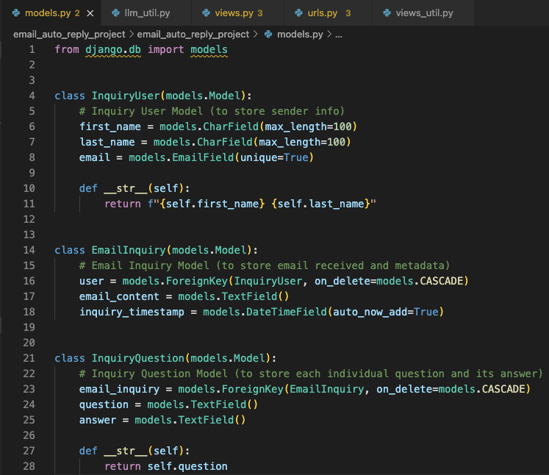
Integrate LLM service using Python
Database Integration
1. Define the Tables
Inquiry user
Email inquiry
Inquiry question

Slide 18
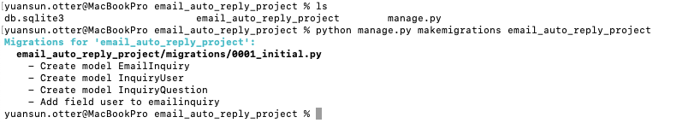

Integrate LLM service using Python
Database Integration
2. Database Migration
python manage.py makemigrations email_auto_reply_project
python manage.py migrate

Slide 19
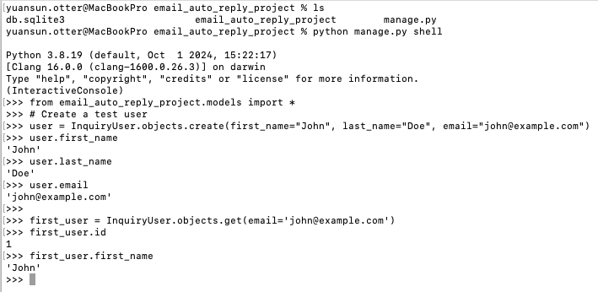
Integrate LLM service using Python
Database Integration
3. Create your First Data Model
python manage.py shell
from email_auto_reply_project.models import *
user = InquiryUser.objects.create()
...
You can create/update/delete data models
from shell.

Slide 20
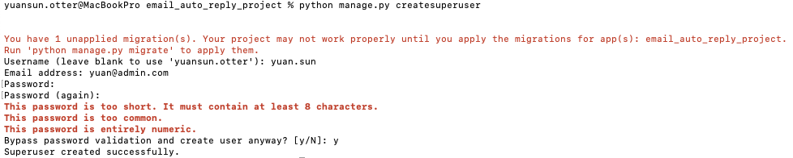
Integrate LLM service using Python
Database Integration
4. Create Admin User
You can also manage the data models from Django built-in Admin dashboard.
To use the Admin Dashboard, you need to create a superuser for yourself.

Slide 21
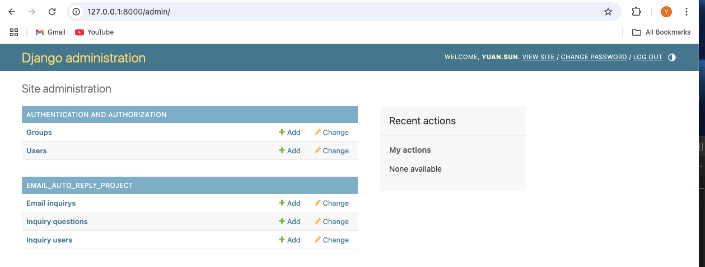
Integrate LLM service using Python
Database Integration
5. User Django Admin Dashboard
http://127.0.0.1:8000/admin/

Slide 22
Any questions?

Slide 23
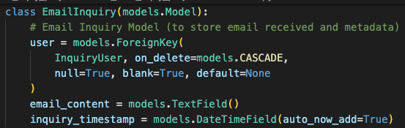
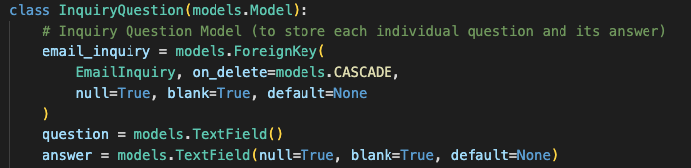
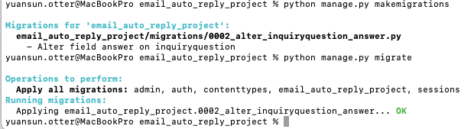
Integrate LLM service using Python
Database Integration
6. Modify Data Model
update models.py
Re-run DB migration
null=True, blank=True

Slide 24
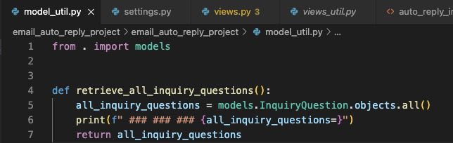
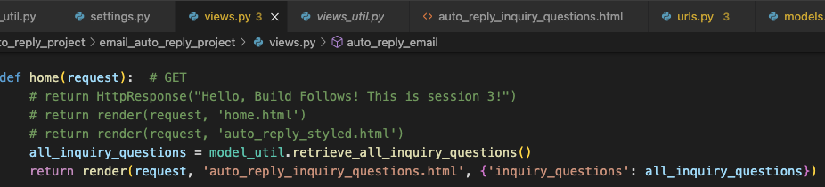
Integrate LLM service using Python
Database Integration
7. Retrieve and Display Questions History
model_util.py
views.py
html

Slide 25
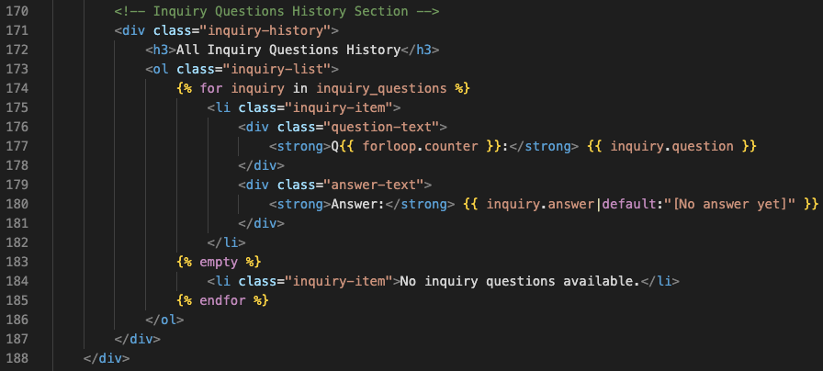
Integrate LLM service using Python
Database Integration
7. Retrieve and Display Questions History
model_util.py
views.py
html

Slide 26
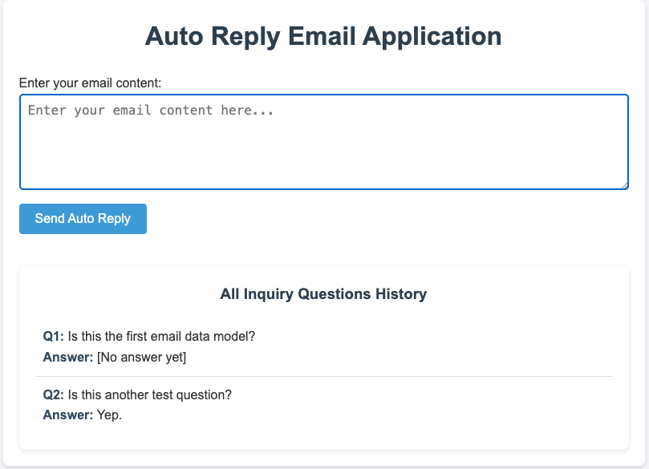
Integrate LLM service using Python
Database Integration
7. Retrieve and Display Questions History

Slide 27
Any questions?

Slide 28
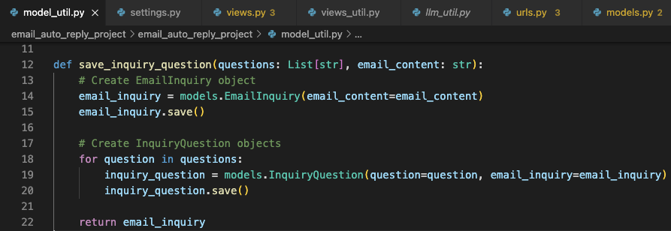
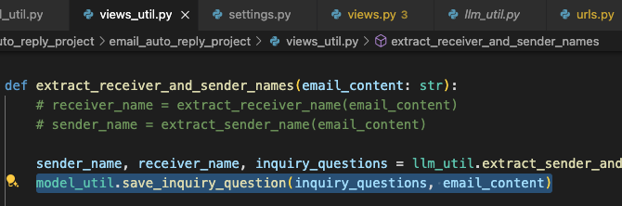
Integrate LLM service using Python
Database Integration
8. Store Extracted Question
model_util.py
views_util.py

Slide 29
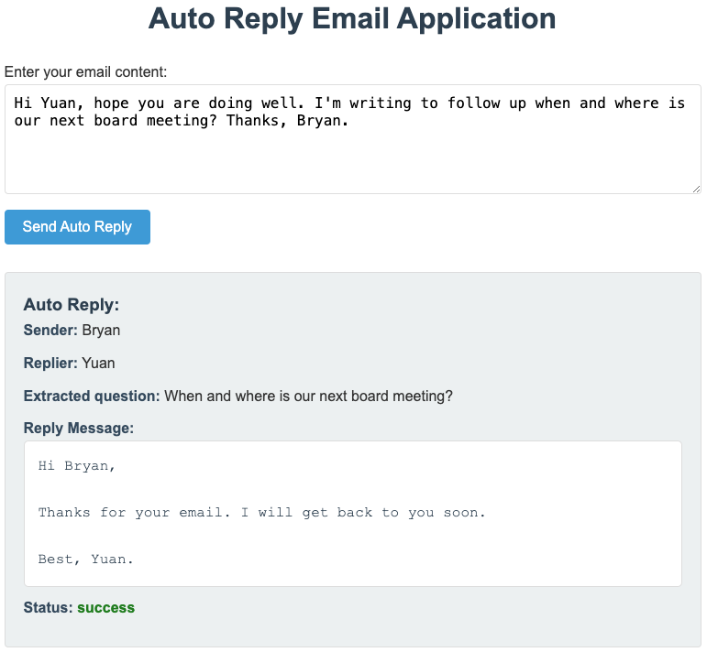
Integrate LLM service using Python
Database Integration
8. Store Extracted Question

Slide 30
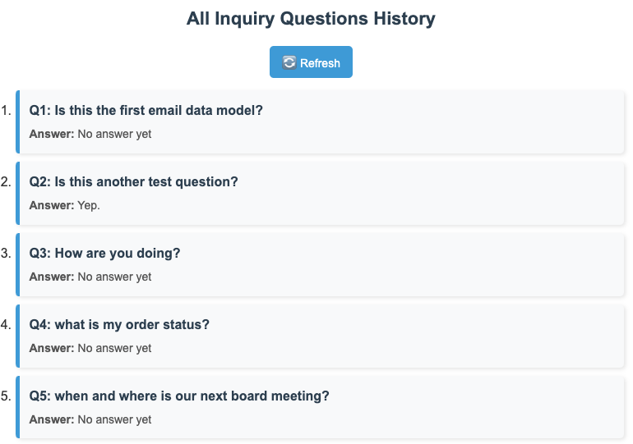
Integrate LLM service using Python
Database Integration
8. Store Extracted Question

Slide 31
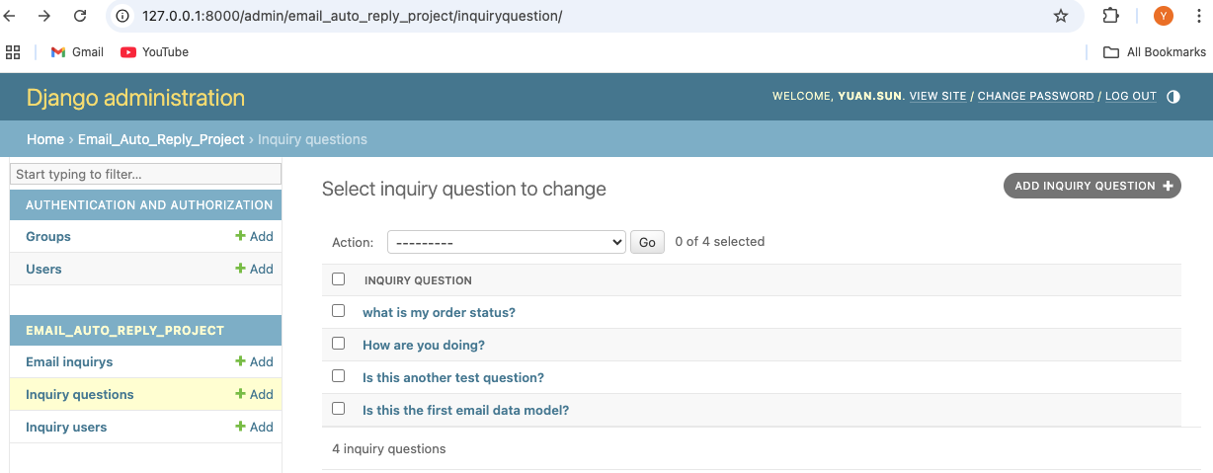
Integrate LLM service using Python
Database Integration
8. Store Extracted Question

Slide 32
Any questions?

Slide 33
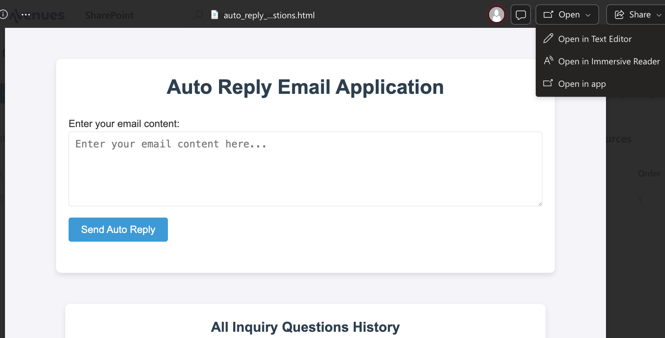
Integrate LLM service using Python
Database Integration
UI Resource
html file in Other Resources folder
Click "Open in Text Editor"

Slide 34
Integrate LLM service using Python
Database Integration
UI Resource
Try ask ChatGPT to style your UI
Send over your html code and describe the UI style you want for your page

Slide 35
Workshop 7. Database Integration
Database Integration
Assignment 3

Slide 36
Integrate LLM service using Python
Assignment 3
Build on the application based on assignment 1 & 2.
Use LLM to extract all inquiry questions from email, besides the sender and receiver names extraction.
Store the extracted questions in database from every input email.
Display all inquiry questions history on the home page.

Slide 37
Integrate LLM service using Python
Assignment 3
Submit assignment 3 by March 31. 2025

